Slide 1
Phishing Attack
~Divyanshu

Slide 2
What is Phishing Attack
Phishing is a type of cyberattack that involves tricking people into sharing sensitive information or installing malware. Phishing attacks can be carried out through emails, text messages, phone calls, or websites.

Slide 3
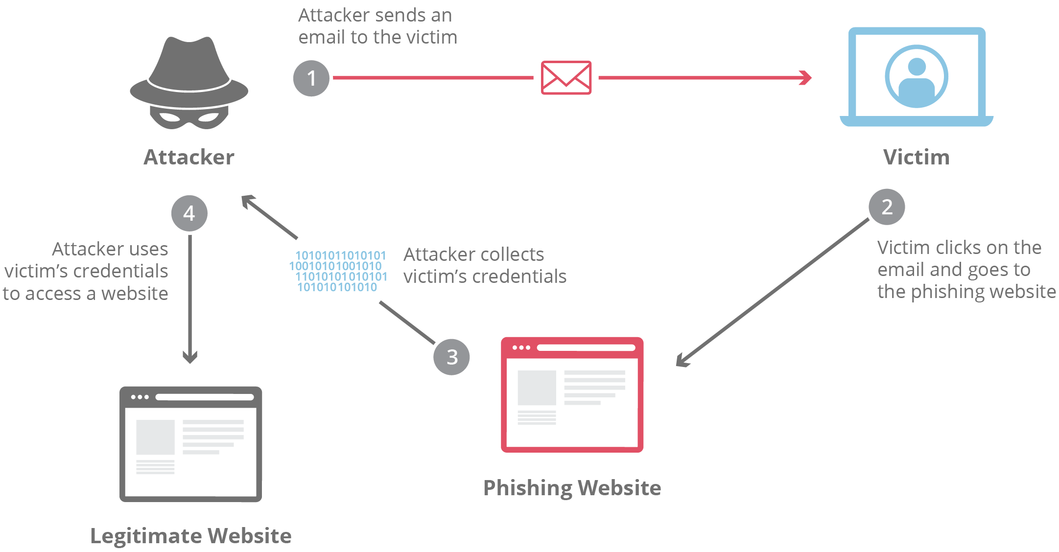
Diagram of Phishing Attack

Slide 4
How does phishing work?
Phishing starts with a fraudulent email or other communication that is designed to lure a victim. The message is made to look as though it comes from a trusted sender. If it fools the victim, he or she is coaxed into providing confidential information, often on a scam website. Sometimes malware is also downloaded onto the target’s computer.

Slide 5
Types of phishing attacks
Deceptive phishing
Spear phishing
Whaling
Pharming

Slide 6
Some ways to avoid phishing attacks:
Don't respond to suspicious requests:
Don't respond to emails or pop-up messages that ask for personal or financial information, especially if you didn't initiate the contact.
Don't click links in suspicious emails:
Links in suspicious emails may contain viruses that can infect your computer.
Report suspicious activity

Slide 7
Why Is Phishing a Problem?
Phishing is a significant problem because it is easy, cheap, and effective for cybercriminals to use. Phishing tactics, particularly email, require minimal cost and effort, making them widespread cyber-attacks. Victims of phishing scams may end up with malware infections (including ransomware), identity theft, and data loss.

Slide 8
Phishing Examples
Attackers prey on fear and a sense of urgency, often using strategies that tell users their account has been restricted or will be suspended if they don’t respond to the email.
Because phishing attacks are typically sent to as many people as possible, the messaging is usually thin and generic. The following illustrates a common phishing email example.

Slide 9
Phishing Techniques
Malicious Web Links
Malicious Attachments
Fraudulent Data Entry Form

Slide 10
Phishing Prevention
Preventing phishing attacks requires a combination of user training to recognize the warning signs and robust cybersecurity systems to stop payloads. Email filters are helpful with phishing, but human prevention is still necessary in cases of false negatives.
Train users to detect a phishing email
Keep software and firmware up-to-date
Avoid clicking links
Install firewalls
Use anti-phishing email security

